Slide 1

Machine Learning
ICT-4261
By-
Dr. Jesmin Akhter
Professor
Institute of Information Technology
Jahangirnagar University

Slide 2
Contents
The course will mainly cover the following topics:
A Gentle Introduction to Machine Learning
Important Elements in Machine Learning
Linear Regression
Logistic Regression
Naive Bayes
Support Vector Machines
Decision Trees and Ensemble Learning
Neural Networks and Deep Learning
Unsupervised Learning

Slide 3
Outline
Decision Trees and Ensemble Learning
Notes:
https://iq.opengenus.org/cart-algorithm/

Slide 4
CART Algorithm
The CART (Classification and Regression Trees) algorithm is a decision tree learning algorithm that can be used for both classification and regression problems in machine learning. It works by recursively partitioning the training data into smaller subsets using binary splits.
CART is a powerful and popular algorithm due to its ability to handle both categorical and continuous features,
CART algorithm is developed by Leo Breiman and Jerome Friedman.
It uses the Gini impurity measure for classification trees and the mean squared error for regression trees.
CART algorithm always creates a binary tree, which means that each non-terminal node has two child nodes. This is in contrast with other tree-based methods, which may allow multiple child nodes
Notes:
ID3 (Iterative Dichotomiser 3) was developed by Ross Quinlan and is used for constructing decision trees. It uses entropy and information gain to decide which attribute is the best to split on at each step. C4.5 is an extension of ID3 and was also developed by Ross Quinlan. C4.5 and C5.0 work with both Discrete and Continuous data.
It includes improvements such as the ability to handle both continuous and discrete attributes, handling of missing data, and pruning of decision trees to avoid overfitting.

Slide 5
Gini Index
Steps 1 Calculate the Gini impurity for the entire dataset. This is the impurity of the root node.
Steps 2 For each input variable, calculate the Gini impurity for all possible split points. The split point that results in the minimum Gini impurity is chosen.
Steps 3 The data is split into two subsets based on the chosen split point, and a new node is created for each subset.
Steps 4 Steps 2 and 3 are repeated for each new node, until a stopping criterion is met. This stopping criterion could be a maximum tree depth, a minimum number of data points in a leaf node, or a minimum reduction in impurity.
Steps 5 The resulting tree is the decision tree.
Gini impurity is a measure of the quality of a split in a decision tree algorithm. Given a sample, the Gini impurity measures the probability of a misclassification if a label is randomly chosen using the probability distribution of the branch.
The Gini impurity of a node can be calculated as follows:
Gini = 1 - ∑(p_{i})²
Here, p_{i} is the probability that a tuple in D belongs to the class C_{i}.
The index reaches its minimum (0.0) when all the samples of a node are classified into a single category.
Notes:
It measures the probability of misclassification of a random sample. The Gini impurity measures how often a randomly chosen element from the set would be incorrectly labeled if it were randomly labeled according to the distribution of labels in the subset.

Slide 6
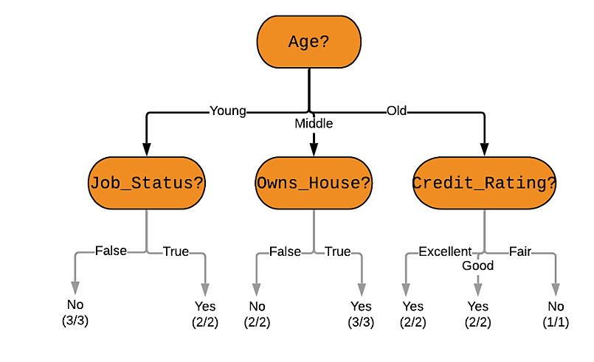
Example
Here is the goal: Use the model to classify future loan applications into one of these classes:
Yes (approved) and
No (not approved)
Let us clasify the following applicant whose record looks like this: Age: Young Job_Status: False Owns_House: False Credit_Rating: Good What would a decision tree look like for the above problem? Here is one example of a decision tree -

Slide 7
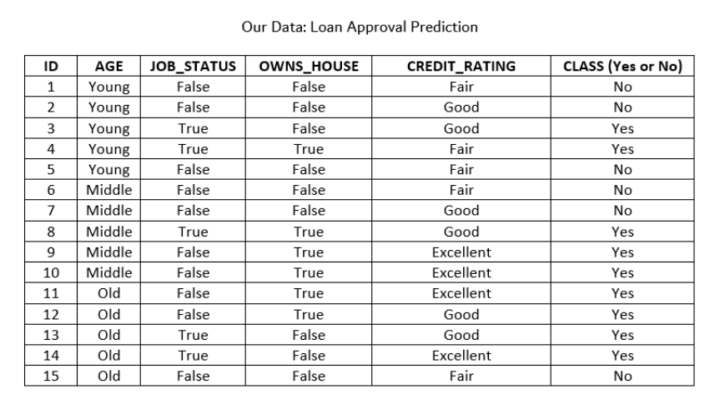
Find Gini Index
Step 1: Find Gini(D) In our case, Gini(D) = 1 - (9/15)² - (6/15)² = 0.48 [since we have 9 Yes and 6 No class values
for the 15 total records]
Step 2: Find Gini_{k}(D) for each attribute k Gini_{k}(D) = ∑|D_{i}|/|D| * Gini(D_{i}) For i = 1 to n, where D_{i} is a partition of the dataset D
So, for the attribute Owns_House: Gini_{Owns_House}(D) = (5/15) * Gini(D_{Owns_House = True}) + (10/15) * Gini(D_{Owns_House = False})
= (5/15) * [1 - (5/5)² - (0/5)²] + (10/15) * [1 - (3/10)² - (7/10)²]
= 0.28
And for the Age attribute: Gini_{Age}(D) = (5/15) * Gini(D_{Age = Young}) + (5/15) * Gini(D_{Age = Middle}) + (5/15) * Gini(D_{Age = Old}) = 0.33
Similarly, we can find the Gini Indices for the other attributes: Gini_{Credit_Rating}(D) = 0.634 Gini_{Job_Status}(D) = 0.32 (try calculating these yourself!)

Slide 9
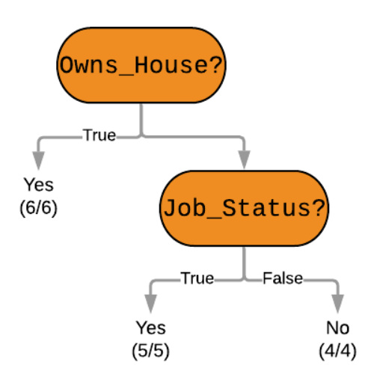
Partition at Minimum Gini Index Values
Step 3: Partition at Minimum Gini Index Values As stated above, we need the root node of the decision tree to have the lowest possible Gini Index, and in our case that is the attribute Owns_House. The next attribute is Job_Status.
This is how we ultimately arrive at this decision tree –
And using this decision tree for our problem - we can see that the applicant does not own a house, and does not have a job. Unfortunately, his loan will not be approved.

Slide 10


Slide 11


Slide 12
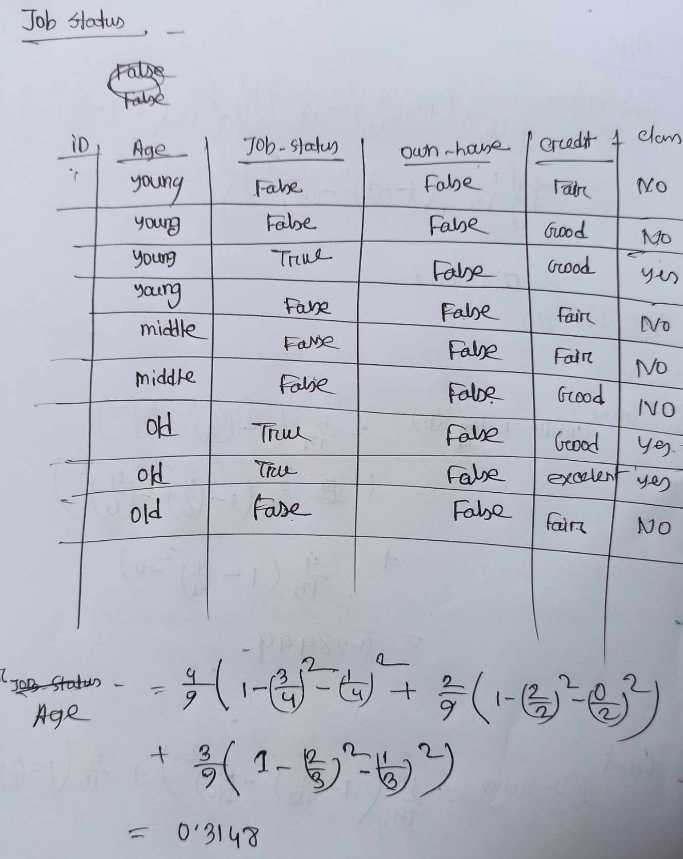

Slide 13
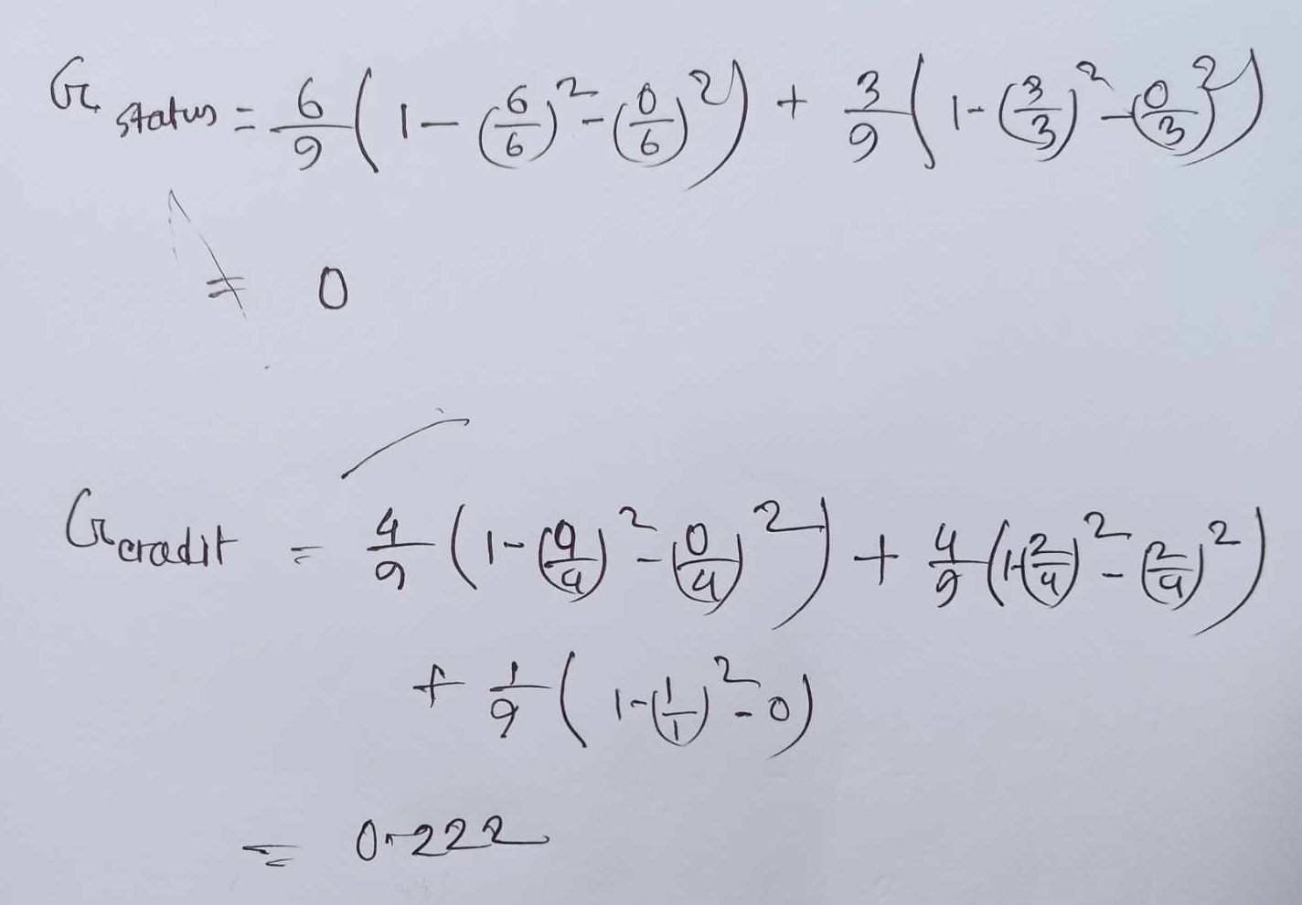

Slide 14
Prediction using CARTs
We saw that decision trees can be classified into two types: Classification trees which are used to separate a dataset into different classes (generally used when we expect categorical classes). The other type are Regression Trees which are used when the class variable is continuous (or numerical).
Our focus is to learn a target function that can be used to predict the values of a continueous class attribute, i.e. this is a prediction problem where we want to know if, given labelled training data, something falls into one class or another.
Let us continue with the Loan Application approval problem, but add an attribute for each applicant - Salary. This is a continuous attribute ranging from zero (for applicants with no jobs), to near infinity. The age and credit rating attributes can also be represented with actual numerical values, instead of the categories they were before. Our new dataset can look like this:

Slide 15
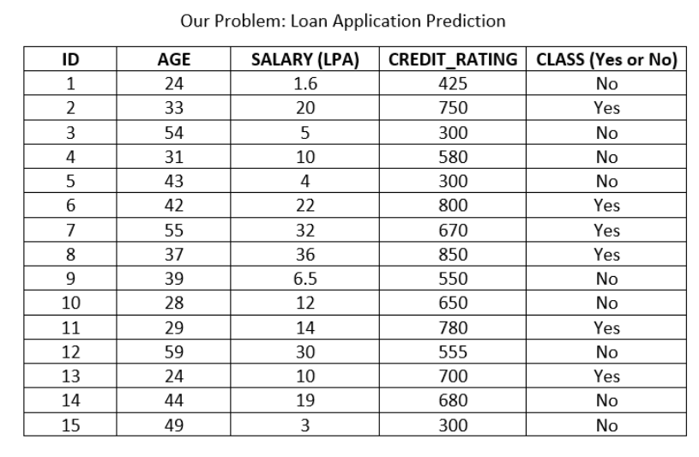
Prediction using CARTs
Now we can build a decision tree to predict loan approval on age, salary, credit rating, and various other variables. In this case, we are predicting values for the continuous variables. And the same CART algorithm we discussed above can be applied here. This is the biggest difference between CART and C4.5
C4.5 cannot support numerical data and hence cannot be used for regression (prediction problems).

Slide 16
Pruning: Getting an Optimal Decision tree
Pruning is a process of deleting the unnecessary nodes from a tree in order to get the optimal decision tree.
A too-large tree increases the risk of overfitting, and a small tree may not capture all the important features of the dataset. Therefore, a technique that decreases the size of the learning tree without reducing accuracy is known as Pruning.
How to avoid/counter Overfitting in Decision Trees?
The common problem with Decision trees, especially having a table full of columns, they fit a lot. Sometimes it looks like the tree memorized the training data set. If there is no limit set on a decision tree, it will give you 100% accuracy on the training data set because in the worse case it will end up making 1 leaf for each observation. Thus this affects the accuracy when predicting samples that are not part of the training set.
Here are two ways to remove overfitting:
Pruning Decision Trees.
Random Forest

Slide 17
Pruning
Pruning is another method that can help us avoid overfitting. It helps in improving the performance of the tree by cutting the nodes or sub-nodes which are not significant. Additionally, it removes the branches which have very low importance.
There are mainly 2 ways for pruning:
Pre-pruning – we can stop growing the tree earlier, which means we can prune/remove/cut a node if it has low importance while growing the tree.
Post-pruning – once our tree is built to its depth, we can start pruning the nodes based on their significance.

Slide 18
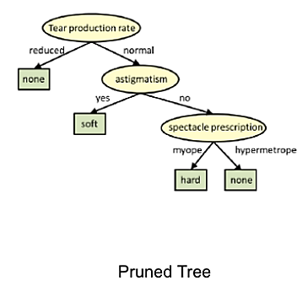
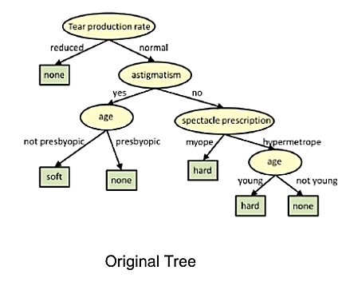
Pruning
In pruning, you trim off the branches of the tree, i.e., remove the decision nodes starting from the leaf node such that the overall accuracy is not disturbed. This is done by segregating the actual training set into two sets: training data set, D and validation data set, V. Prepare the decision tree using the segregated training data set, D. Then continue trimming the tree accordingly to optimize the accuracy of the validation data set, V.
In the above diagram, the ‘Age’ attribute in the left-hand side of the tree has been pruned as it has more importance on the right-hand side of the tree, hence removing overfitting.

Slide 19
Thank You

